Slide 1
Figures added to textbook already

Slide 2
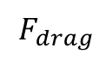
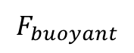
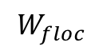
Free Body Diagram
terminal_velocity_FBD.png
$$F_{buoyant}$$
$$F_{drag}$$
$$W_{floc}$$

Slide 3
drag_coeff_Re_base.png
Stokes Law

Slide 4
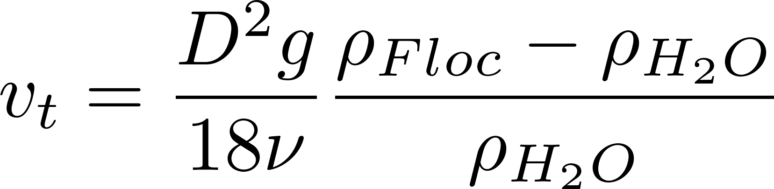
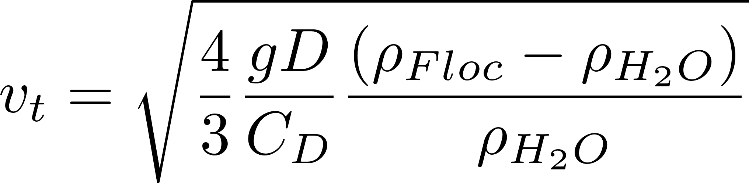
drag_coeff_Re_full.png
Stokes Law
laminar
turbulent
turbulent boundary

Slide 5
terminal_velocity_floc_diam.png
Floc blanket velocity
AguaClara plate settler capture velocity
Primary particle terminal velocity

Slide 6
horizontal_flow_tank_base.png
W
H
entrance
exit
L

Slide 7
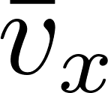
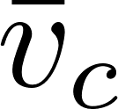
horizontal_flow_tank_capture.png
W
H
entrance
exit
L

Slide 8
horizontal_flow_tank_small_capture.png
W
H
entrance
exit
L

Slide 9
vertical_flow_tank_base.png
exit
L
W
H
entrance

Slide 10






sed_tank_overview.png

Slide 11
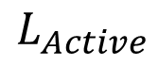
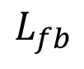
sed_tank_flow_conserve.png
“lost triangle”
$$L_{Active}$$
$$L_{fb}$$

Slide 12
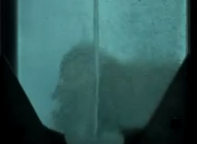
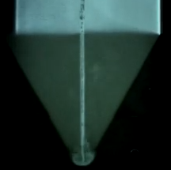
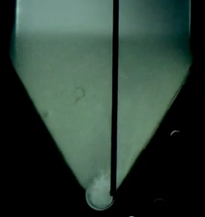
jet_placement.png
Flat bottom
Centered jet
Offset jet

Slide 13
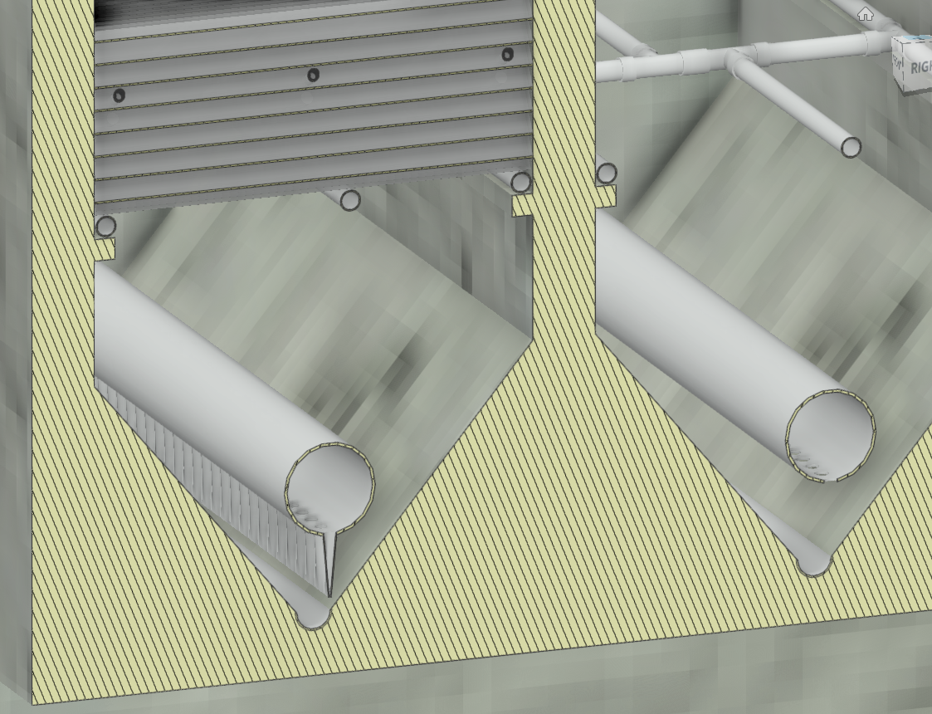
sed_cross_section.png
Diffusers
Floc pickup location
Jet reverser

Slide 14
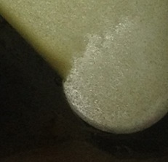
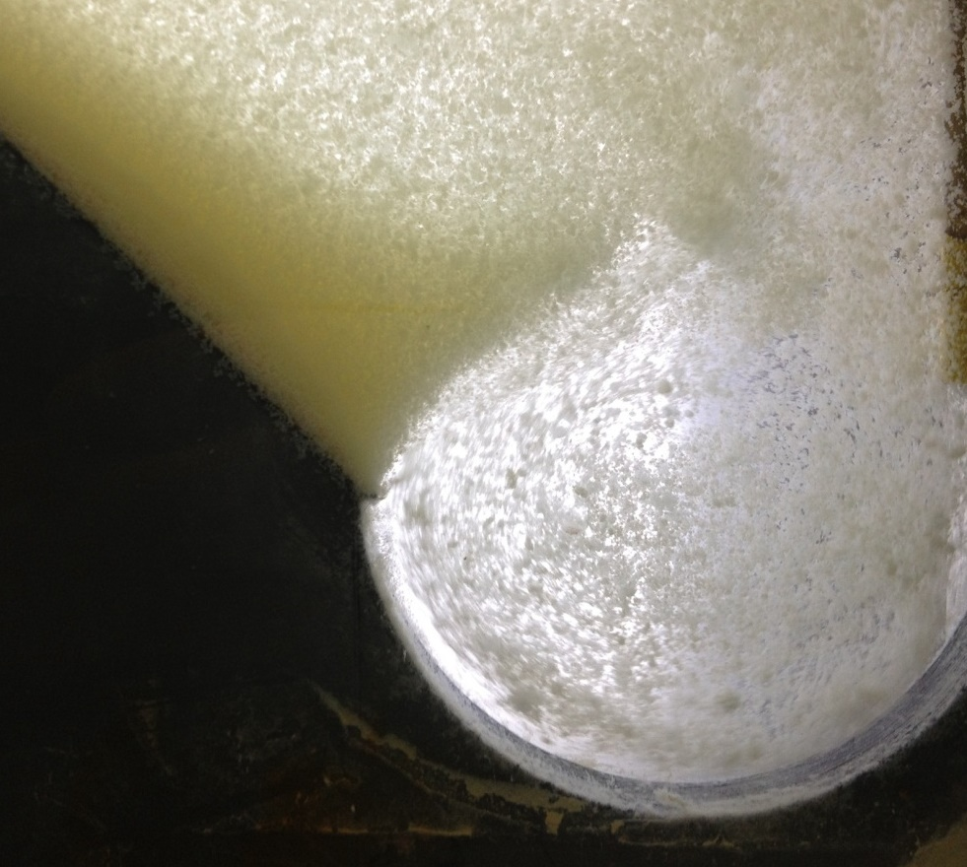
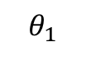
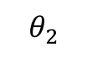
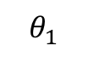
jet_angle.png
Current of settled flocs
Current of settled flocs
$$θ_{1}$$
$$θ_{2}$$
Jet
Jet
3.9 mm Jet Diameter
8.9 mm Jet Diameter
$$θ_{1}$$
<
$$θ_{2}$$

Slide 15
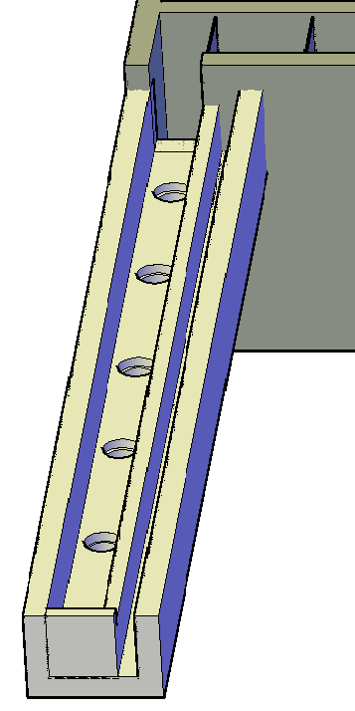
influent_channel_bays.png
Pipes to
sedimentation bays
Influent channel

Slide 16
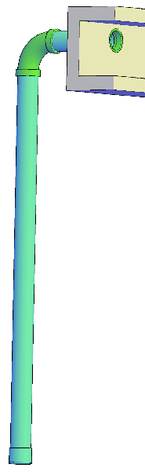
influent_channel_manifold.png
Influent channel
Influent manifold

Slide 17
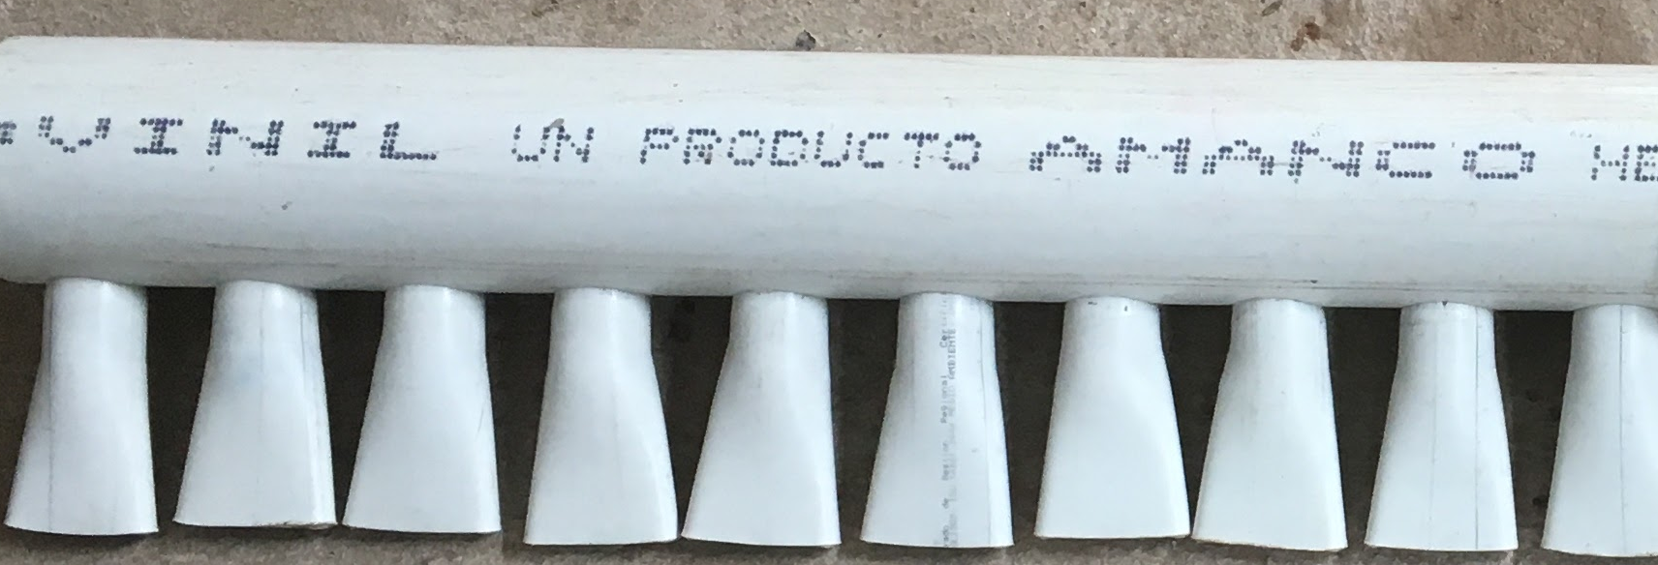
influent_manifold_diffuser_base.png
Influent manifold
Diffusers

Slide 18
influent_manifold_diffuser_flow.png
Influent manifold
Diffusers

Slide 19
flow_circulation.png

Slide 20
flow_straightening.png

Slide 21
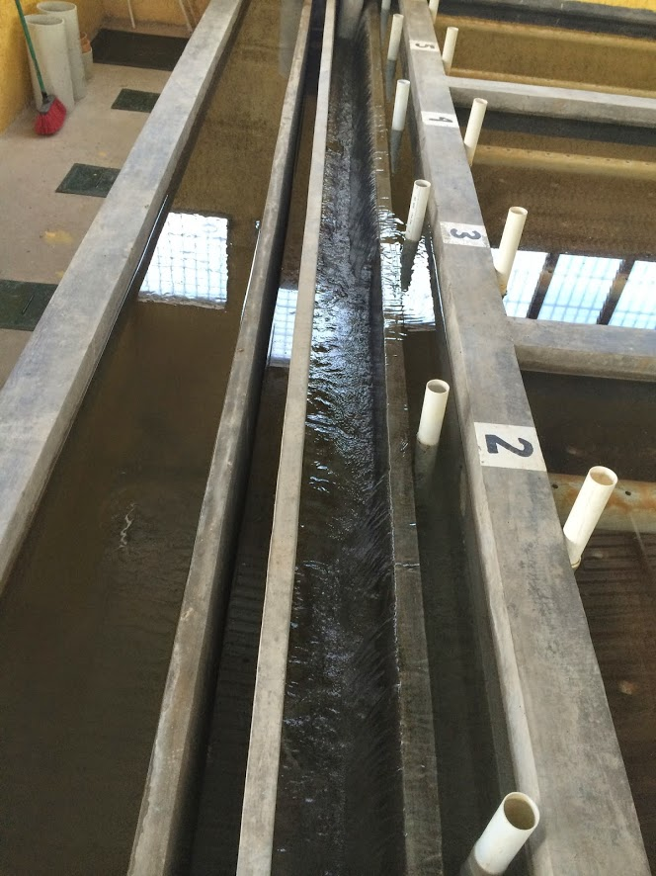
channel_labeled.png
Pipe stubs to block sed tank influent manifolds
Sensor access to floc hopper
Settled water effluent channel
Weir that controls water level in sed tank (and flocculator)
Settled water effluent channel
Water to waste
Influent channel

Slide 22
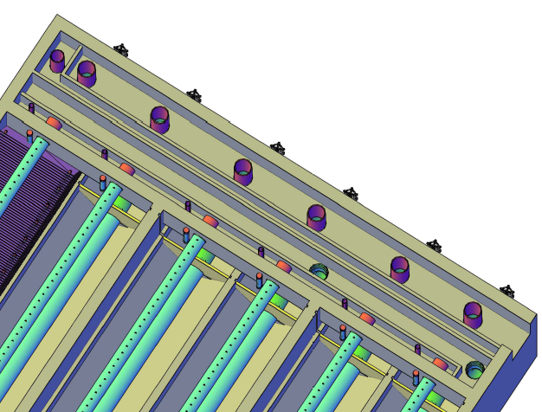
channel_labeled_cad.png
Drain for flocculated water
Weir that controls the water level in the flocculator when flocculating to waste
Wall between inlet and outlet channels
Weir that controls the water level in the sedimentation tank (and flocculator)
Exit to the filters
Entrance from the flocculator

Slide 23
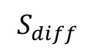
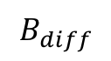
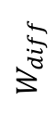
BvsS_diffuser.png
$$B_{diff}$$
$$S_{diff}$$
$$W_{diff}$$

Slide 24
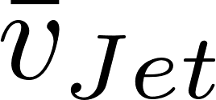
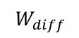
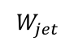
Wdiff_Wjet.png
$$W_{diff}$$
$$W_{jet}$$

Slide 25
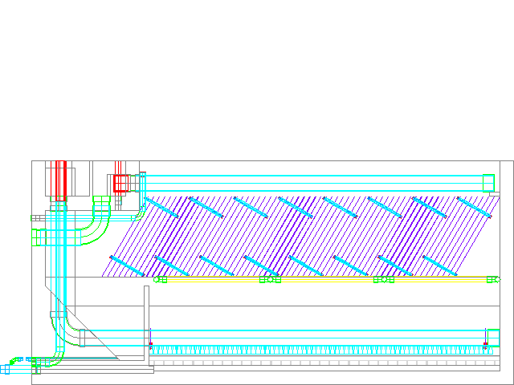
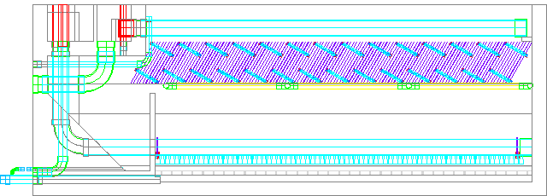
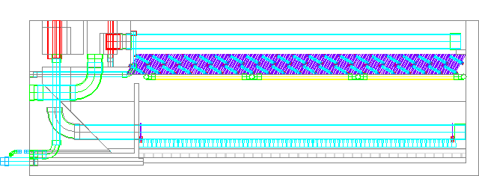
plate_settler_depth.png
5 cm spacing = 2.27 m deep
2.5 cm spacing = 1.84 m deep
1 cm spacing = 1.64 m deep

Slide 26
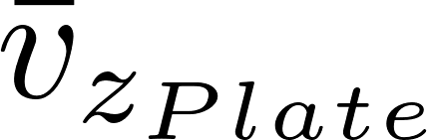
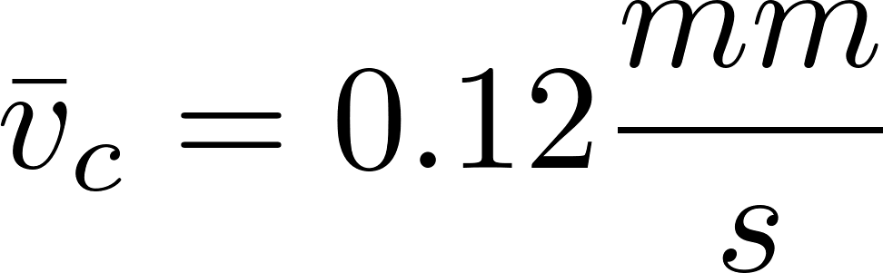
floc_vsed.png

Slide 27
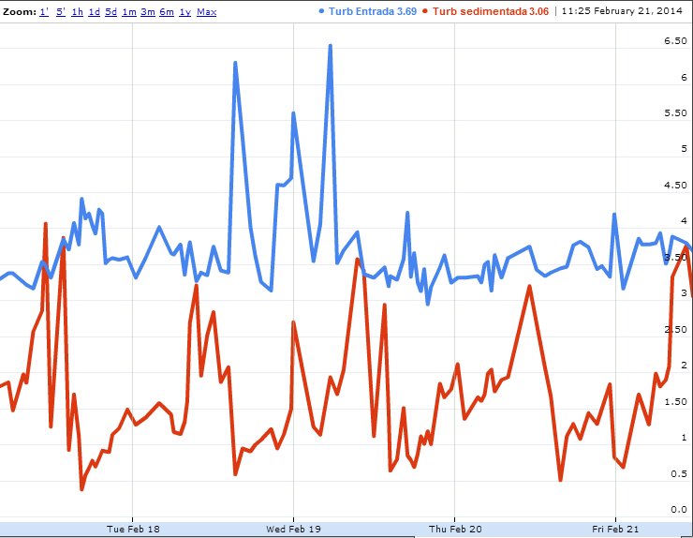
temp_turbidity.png
Raw water
Turbidity (NTU)
Settled water

Slide 28
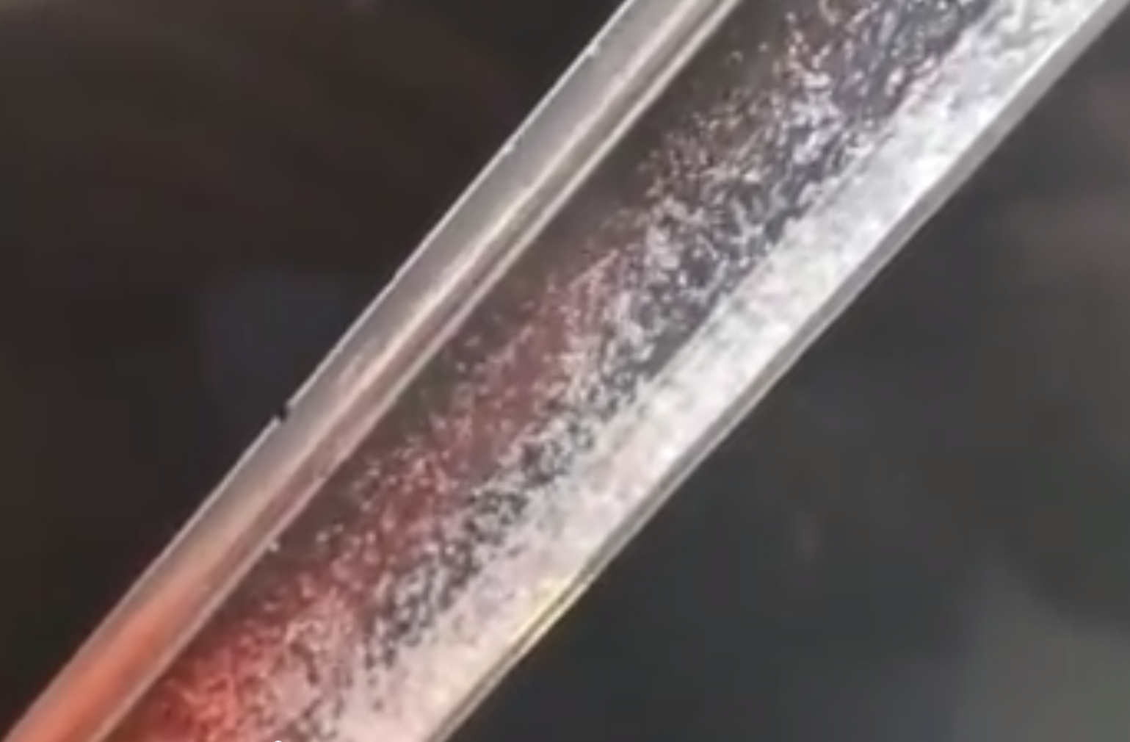
temp_tube_settler.png

Slide 29
plate_settler_boundary_conditions.png
y
S
τ
u
x

Slide 30
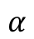
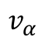
floc_rollup_base.png
$$v_{α}$$
$$α$$

Slide 31
floc_rollup_step1.png
$$v_{α}$$
$$α$$

Slide 32
floc_rollup_step2.png
$$v_{α}$$
$$α$$

Slide 33
floc_rollup_step3.png
$$v_{α}$$
gsin(α)
$$α$$

Slide 34

plate_settler_headloss_diag.png
P
τ
u
$∆$P

Slide 35
plate_settler_headloss_spacing.png

Slide 36
floc_conc_G.png

Slide 37
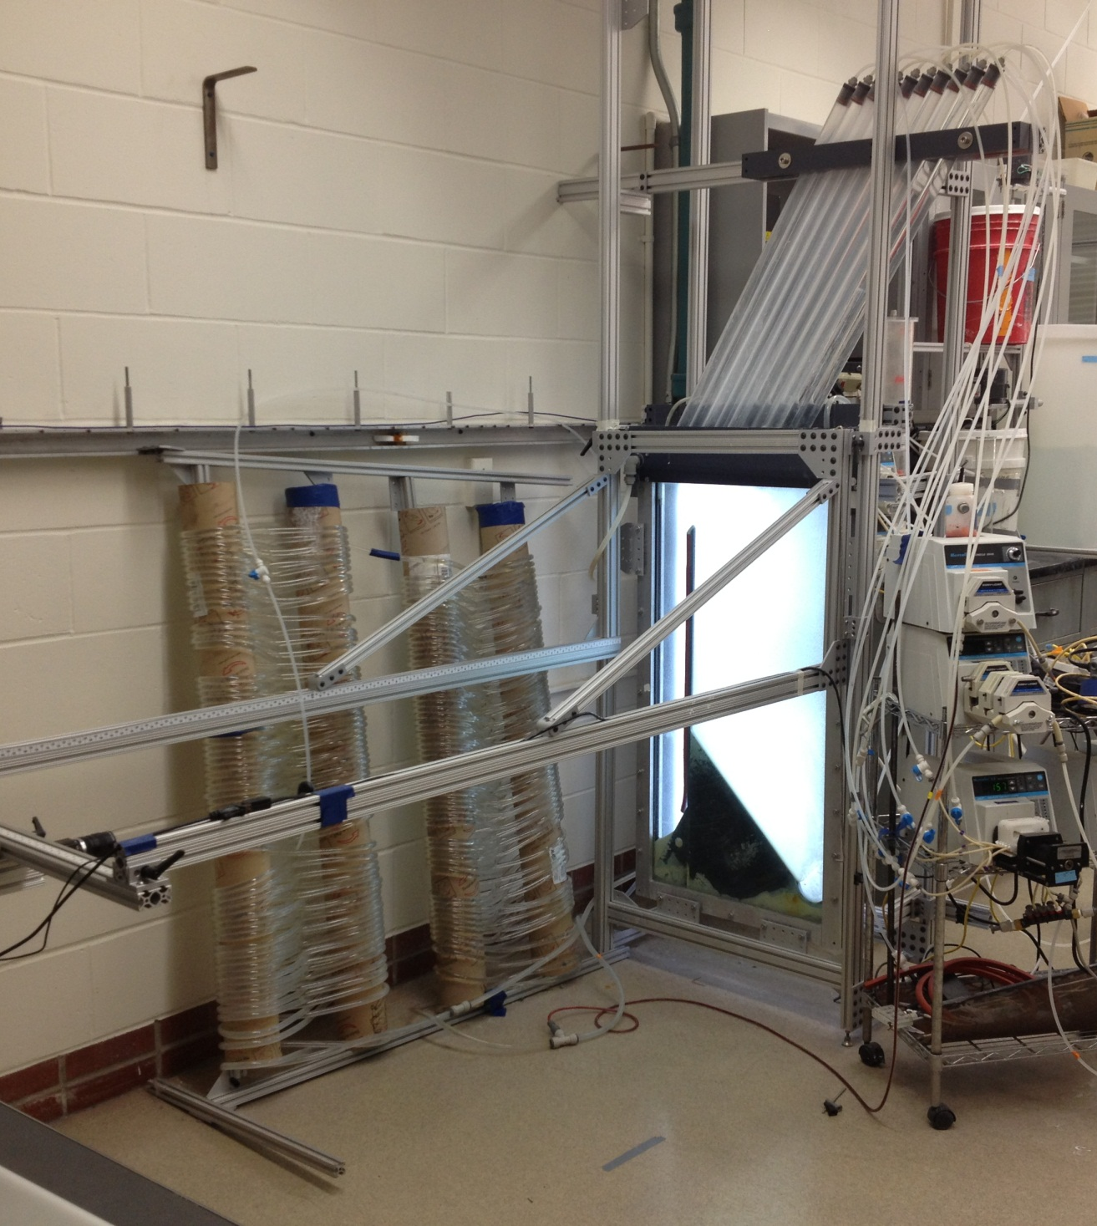
lab_setup.png
Plate Settlers
Flocculator
Sedimentation Tank

Slide 38
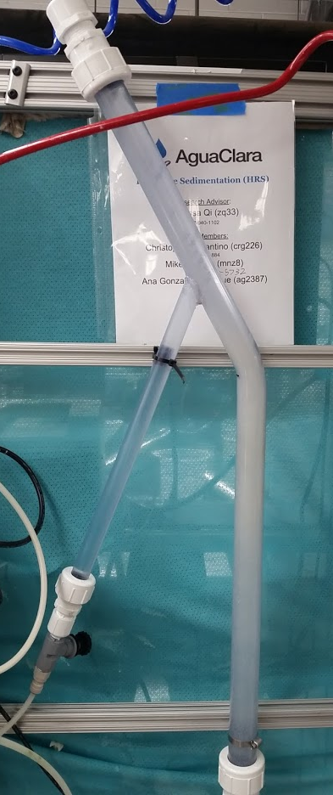
benchtop_sed.png
Plate Settler
Floc Hopper
Floc Blanket
Sedimentation Tank

Slide 39
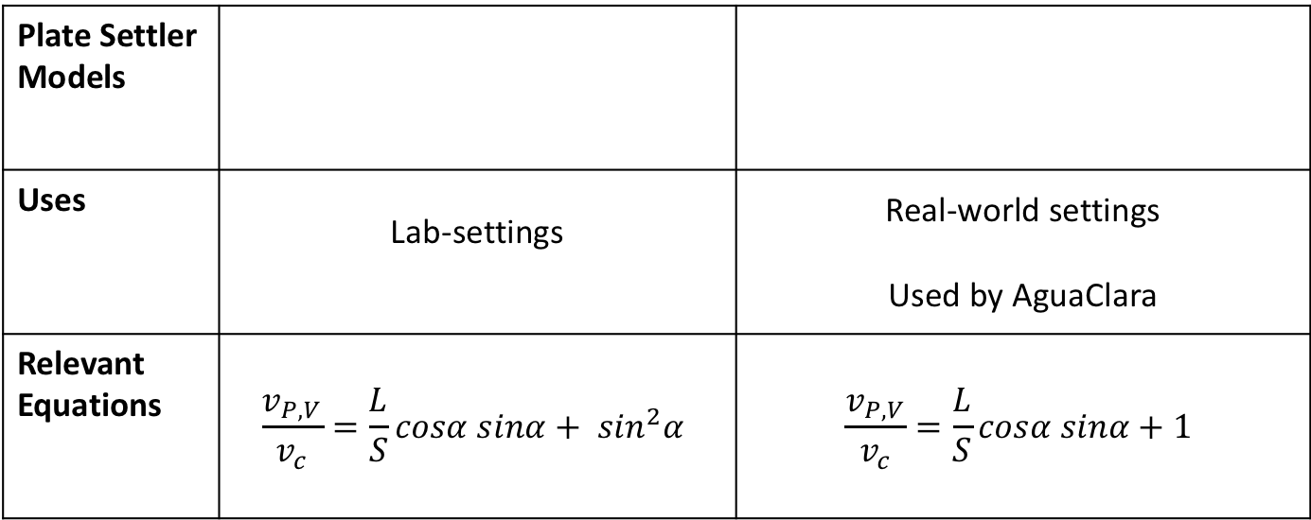
plate_settler_model_table.png
Plate Settler Models
Uses | Lab-settings | Real-world settings Used by AguaClara
Relevant Equations | $$\frac{v_{P,V}}{v_{c}}=\frac{L}{S}cosα sinα+ \sin^{2}α$$ | $$\frac{v_{P,V}}{v_{c}}=\frac{L}{S}cosα sinα+1$$
Note: need to add citations somehow

Slide 40
plate_settler_critpath.png
Critical path
L
H
α

Slide 41
plate_settler_critheight.png
Critical path
H_{c}
L
H
S
α

Slide 42
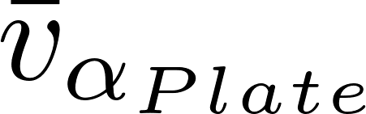
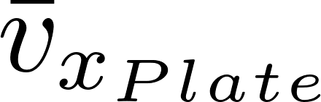
plate_settler_valpha.png
L
H
S
α

Slide 43


plate_settler_vnet.png
L
H
S
α

Slide 44
SvsBplatesettlers.png
H
L
S
B
α

Slide 45
plate_settler_base.png
L
H
S
α

Slide 46
circuit_base.png
head and potential energy to drive flow
effluent manifold
effluent manifold exit losses
“battery”
effluent manifold orifices
“resistor”
floc blanket and plate settlers
diffusers
influent channel
influent manifold
effluent channel
90° bend
effluent manifold
effluent manifold exit losses
effluent manifold orifices
floc blanket and plate settlers
diffusers
influent manifold
90° bend

Slide 47
circuit_full.png
head and potential energy to drive flow
effluent manifold
effluent manifold exit losses
“battery”
effluent manifold orifices
“resistor”
floc blanket and plate settlers
diffusers
“bad” head loss
influent channel
influent manifold
“good” head loss
effluent channel
90° bend
effluent manifold
effluent manifold exit losses
effluent manifold orifices
floc blanket and plate settlers
diffusers
influent manifold
90° bend

Slide 48
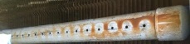
effluent_manifold.png
a
a
a
a
a
a
side-view of effluent manifold
top-view of effluent manifold

Slide 49
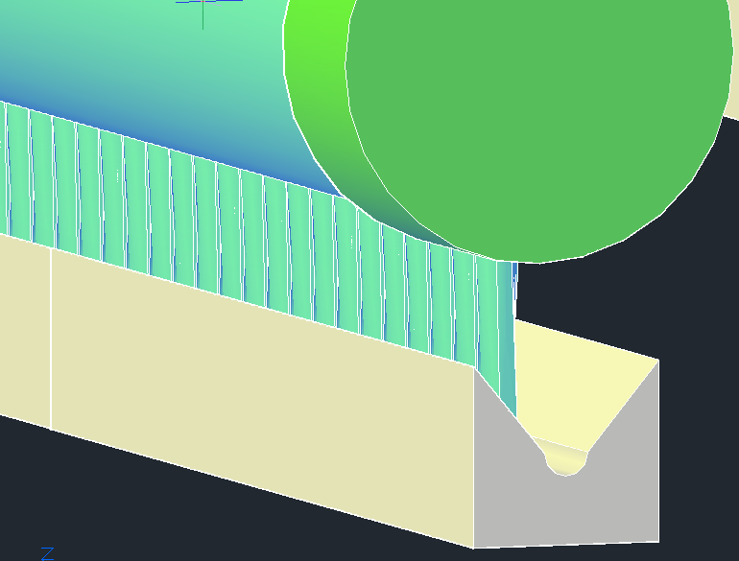
bottom_of_sed_tank_detail.png
Influent manifold
Diffusers
Sloped bottom geometry
with jet reverser

Slide 50
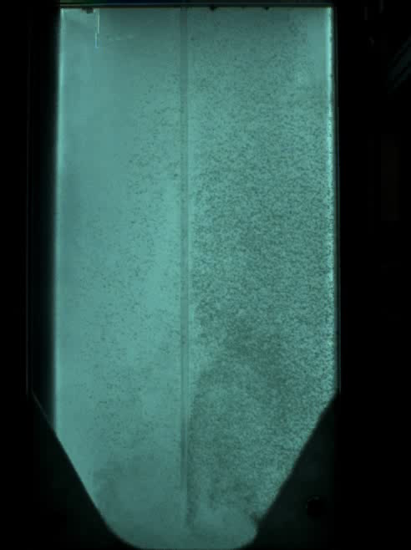
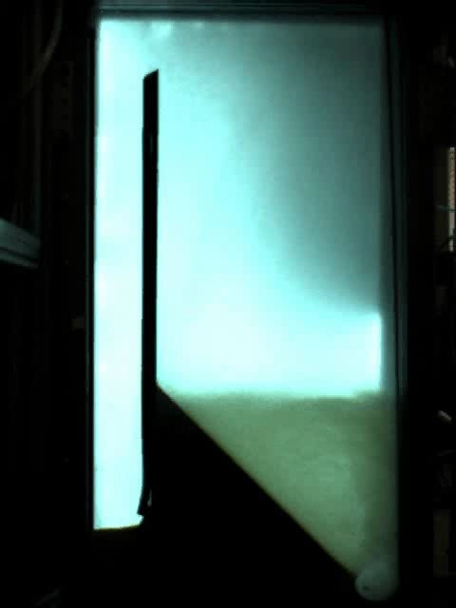
VIDEO
Floc Hopper
Upflow velocity is 1 mm/s
Jet Reverser
Flat bottom
Sloped bottom

Slide 51
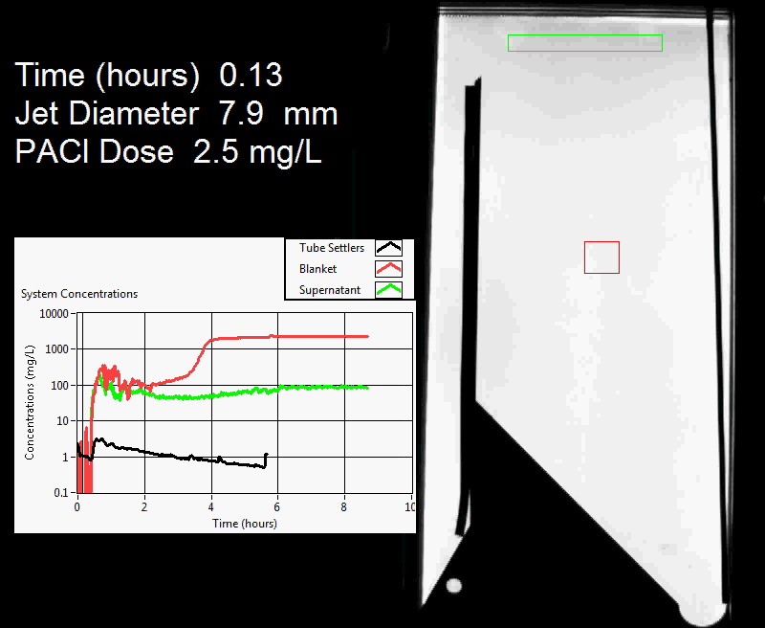
floc_blanket_experiment.png

Slide 52
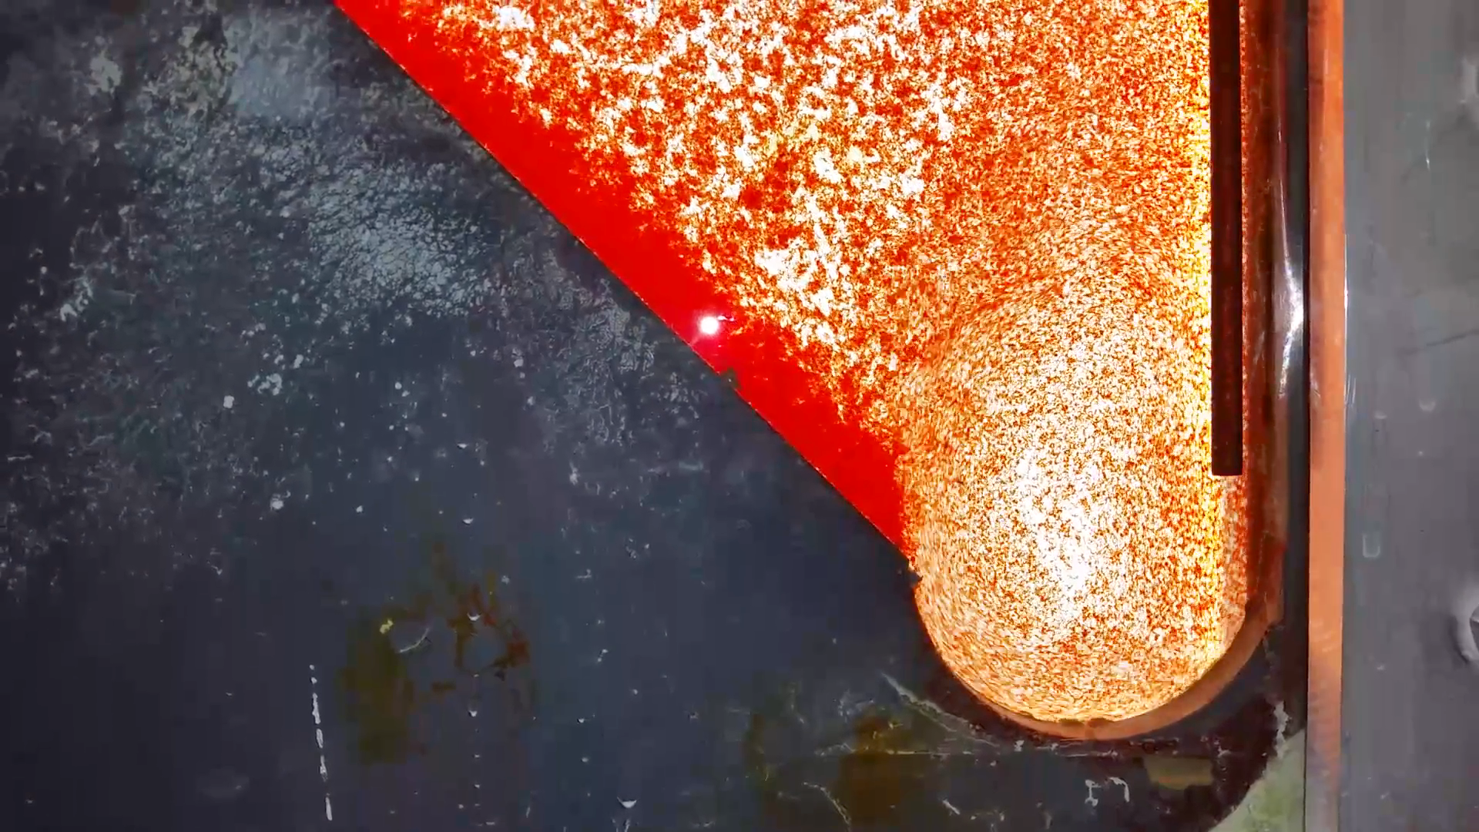
diffuser_jet_reverser.png
7.5 cm

Slide 53
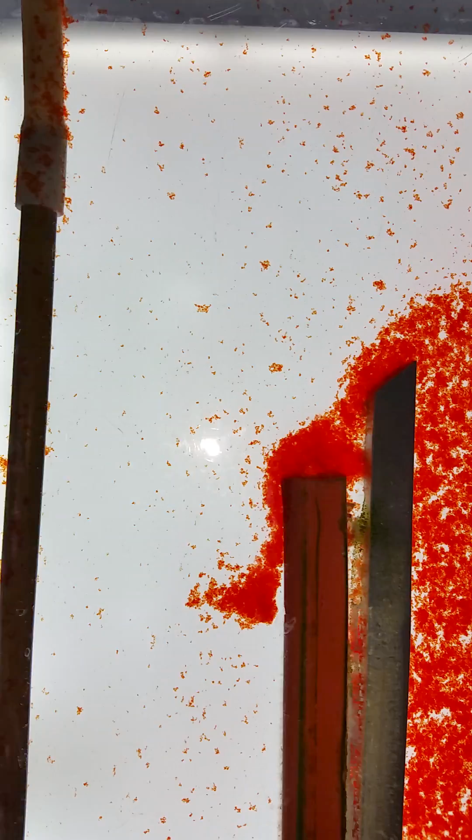

floc_hopper_highlight.png

Slide 54

$$v_{α}$$
$$v_{α}$$
Notes:
floc_rollup.png

Slide 55





vslide_vsettle.png
If $v_{Slide}$ is bigger than $v_{c}$, then some flocs that we expected to capture will slide out the top
Floc Roll-up and its Implications for the Spacing of Inclined Settlers Matthew W. Hurst, Michael J. Adelman, Monroe L. Weber-Shirk, Tanya S. Cabrito, Cosme Somogyi, and Leonard W. Lion. Journal of Environmental Engineering, submitted (2012)
$$v_{c}$$
$$v_{Slide}$$
($v_{Slide}/v_{c}$)
Note: All experiments were performed at the same settle capture velocity
Notes:
Floc Roll-up and its Implications for the Spacing of Inclined Settlers Matthew W. Hurst, Michael J. Adelman, Monroe L. Weber-Shirk, Tanya S. Cabrito, Cosme Somogyi, and Leonard W. Lion. Journal of Environmental Engineering, submitted (2012)

Slide 56
diffuser_jetreverser.png
Inlet diffuser
50°
Jet Reverser

Slide 57

Notes:
Why does the plug have a vertical tube? Serves as a handle and an air vent.

Slide 58
Dump poorly flocculated water channel
Exit Weir that controls water levels all the way upstream to the next free fall (LFOM!)
Notes:
Exercise: Tell the story of the journey of a large floc, a small floc, a rouge loner clay particle, and of a water molecule as each travels through this sedimentation tank.
How do plate settlers work

Slide 59
failure_mode_example.png
1 m
Sedimentation tank
cross-section showing proposed bottom geometry
Single slot
Influent manifold/drain

Slide 60

diffuser_side_bottom_top.png

Slide 61



Notes:
diffuser_fabrication.png

Slide 62
Figures to be added to textbook

Slide 63


inlet_manifold_designs.png
NEEDS EDITING

Slide 64


Slide 65


Slide 66


Slide 67

flow_complication.png

